Slide 1
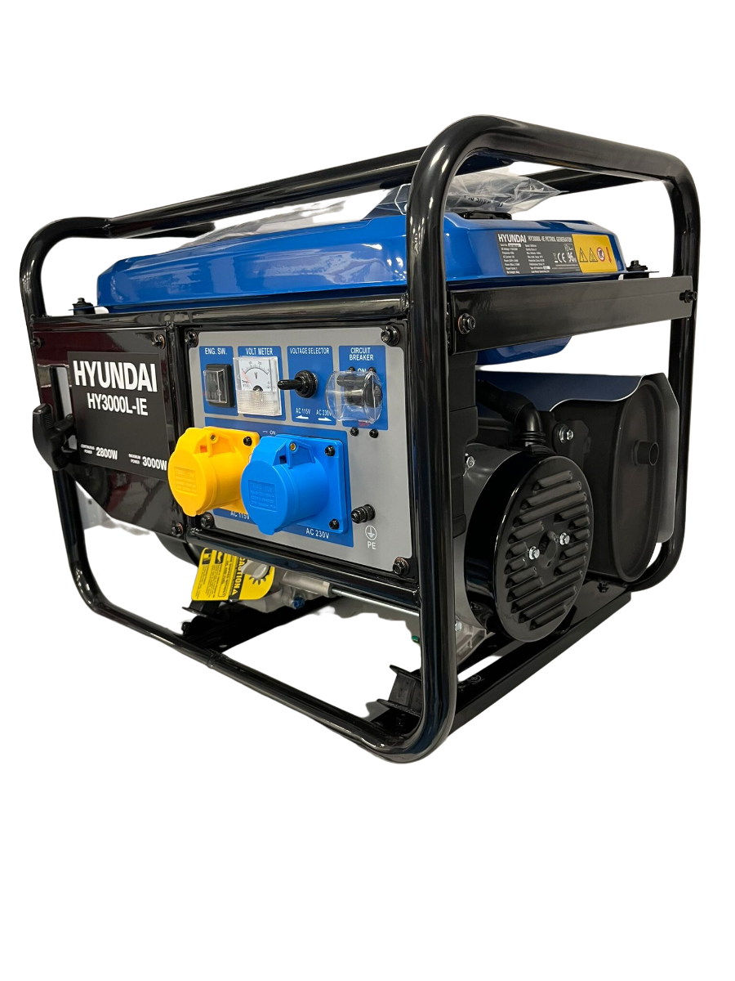

in

Slide 2
Generators in Python
in

Slide 3

About me
Vytautas Sluckas
linkedin.com/in/vytautas-sluckas/
What do I do
Data Engineer at Exacaster
Python Lecturer at Code Academy
Hobbies
Jogging
Going to gym
Video games
Spending time with friends
Movies

Slide 4



Jogging
Going to gym
Video games
Spending time with friends
Movies

Slide 5
Generators in Python
Back to …
in

Slide 6
Okay so what it is and how to get started…

Slide 7

Why even bother using generators?
[]

Slide 8
Memory Efficiency: Generators produce values one at a time and don't store the entire sequence in memory, making them efficient for working with large datasets or infinite sequences.

Slide 9
Lazy Evaluation: Values are generated only when needed, which can improve performance and reduce unnecessary computation.

Slide 10
Infinite Sequences: Generators can represent infinite sequences, which is not feasible with lists.

Slide 11
Pipelining and Composition: Generators can be easily combined to create complex data processing pipelines, enabling modular and readable code.

Slide 12
Natural Iteration: Generators can be iterated over using for loops or consumed by functions that expect iterators, making them seamlessly integrate into Python's iteration model.

Slide 13
Cleaner Code: Generators often result in more concise and readable code compared to traditional loop-based approaches.

Slide 14
Stateful Processing: Generators can maintain state across multiple calls, allowing for sequential processing of data.

Slide 15
Exception Handling: Generators can handle exceptions and cleanup in a more structured manner.

Slide 16
cons
TL;DR
pros
Save up memory
Lazy evaluation
Infinite sequences
Clean code with for loops etc.
Stateful processing
Ability to build pipelines
No iterating twice.
No indexing of results
Could be tricky estimating how much data is actually being read.
Complexity

Slide 17


Questions?

